Slide 1





Email Spam Detection
Team :
Gopu Pallavi , pallavireddy593@gmail.com
Penakacharla Ruchitha Yadav, penakacharlaruchitha1423@gmail.com
Sushmitha R , sushmitha3193@gmail.com
Golla Geethanjali , gollageethanjali1@gmail.com
Guide : Saomya chaudhury
Disclaimer: The content is curated for educational purposes only.
Notes:
Slides: Prepare a short slide deck (10-12 slides) summarizing the project objectives, methodology, and key results.

Slide 2
OUTLINE
Abstract of the Project
Problem Statement
Proposed Solution
System Architecture
Live Demo of the Project
Embedded Video of Project
Conclusion
Future Scope

Slide 3
Abstract
The "Email Spam Detection" project, undertaken as part of the TSP 4.0 Capstone Project, aimed to develop a robust machine learning model capable of accurately classifying emails as either spam or legitimate. This was achieved through a systematic process involving data acquisition, preprocessing, feature extraction, model training, and evaluation. The project utilized the publicly available "Email Spam" dataset from Kaggle, providing a foundation of labeled email text for analysis and it is also creating a functional system capable of automatically filtering spam emails, and showcasing the steps involved in a comprehensive data science project.

Slide 4
Problem Statement
The proliferation of unsolicited bulk emails, commonly known as spam, poses a significant challenge to individuals and organizations alike. Spam emails not only clutter inboxes and waste valuable time, but they also represent a substantial security risk, often containing phishing attempts, malware, and other malicious content. Traditional rule-based spam filters are frequently inadequate in addressing the evolving tactics of spammers, resulting in a persistent need for more sophisticated and adaptive solutions.

Slide 5
Proposed Solution
Develop a machine learning model capable of accurately classifying emails as either spam or legitimate ("ham"). This is the primary objective, focusing on the core functionality of the project.
Train and evaluate a Multinomial Naive Bayes classification model to achieve effective spam detection. This objective specifies the chosen machine learning algorithm and the evaluation process.
Enhance understanding of text classification and spam filtering techniques. This objective highlight the learning goals of the project.
Produce a comprehensive project report documenting the methodology, implementation, and results of the spam detection system. This objective addresses the documentation and reporting requirements of the project.

Slide 6
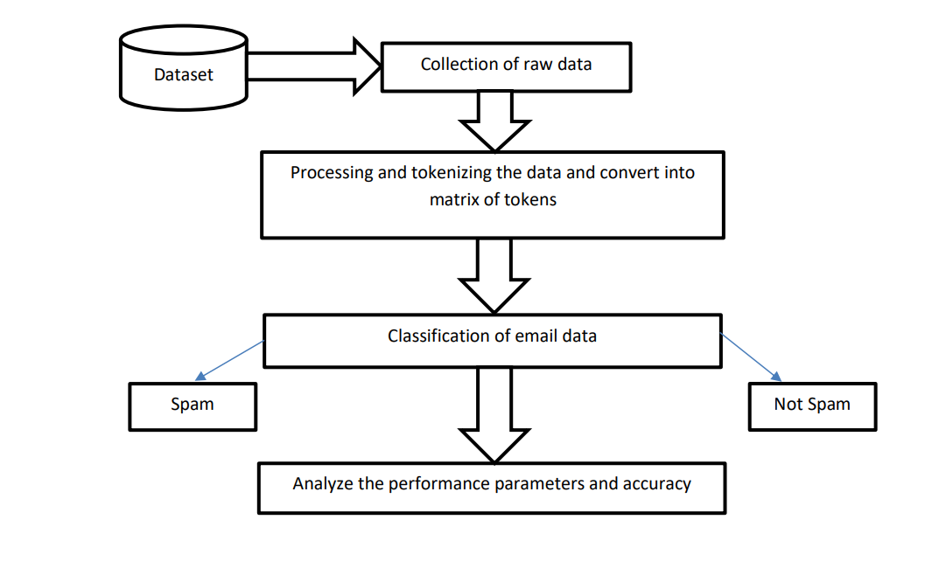
System Architecture

Slide 7
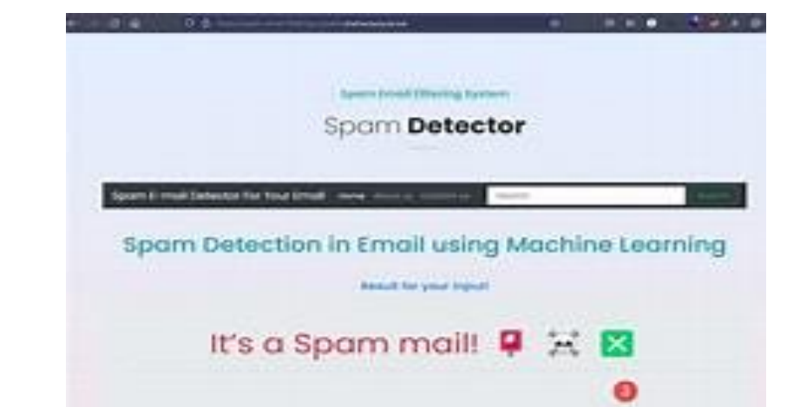
Live Demo of Project

Slide 8
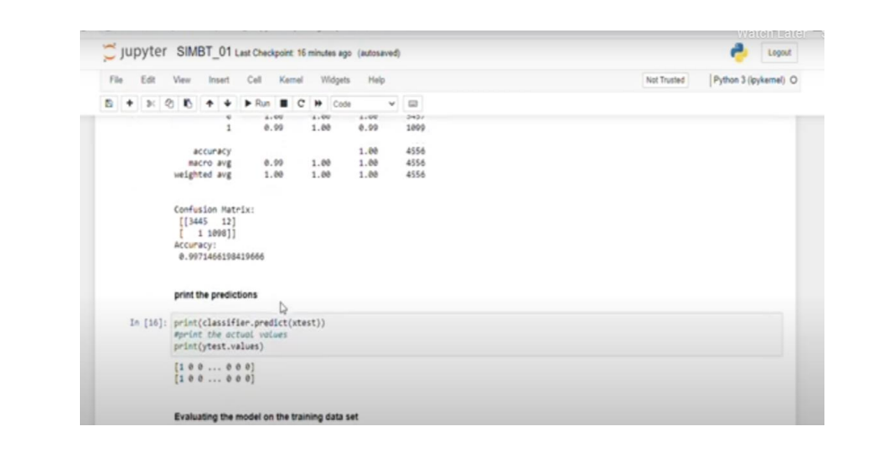
Video of Project Demo

Slide 9
Future Scope
"This project, 'Email Spam Detection,' was chosen due to the persistent and evolving challenge that spam emails pose in today's digital landscape. The motivation stems from the recognition that traditional spam filtering methods often fall short in effectively addressing the sophisticated tactics employed by spammers. Spam not only clutters inboxes, leading to decreased productivity, but also poses significant security risks, including phishing attempts, malware distribution, and data breaches. By developing a machine learning-based spam detection system, this project aims to provide a more adaptive and accurate solution. The potential applications of this system are vast, ranging from individual email clients to enterprise-level security solutions, thereby enhancing email security and user productivity. The impact of such a system would be a reduction in the time wasted dealing with spam, a decrease in the risk of falling victim to email-based cyberattacks, and an overall improvement in the efficiency and security of digital communication. Ultimately, this project contributes to the broader goal of creating a safer and more productive online environment."

Slide 10
CONCLUSION
The results of this study demonstrate that the developed email spam detection system offers a reliable and effective solution for protecting users from unwanted and potentially harmful emails.

Slide 11
Thank you!
Notes:
thank you very much for joining this PPT, keep learning.
11

